Slide 1
Change in signal laterality
Sid Rana

Slide 2
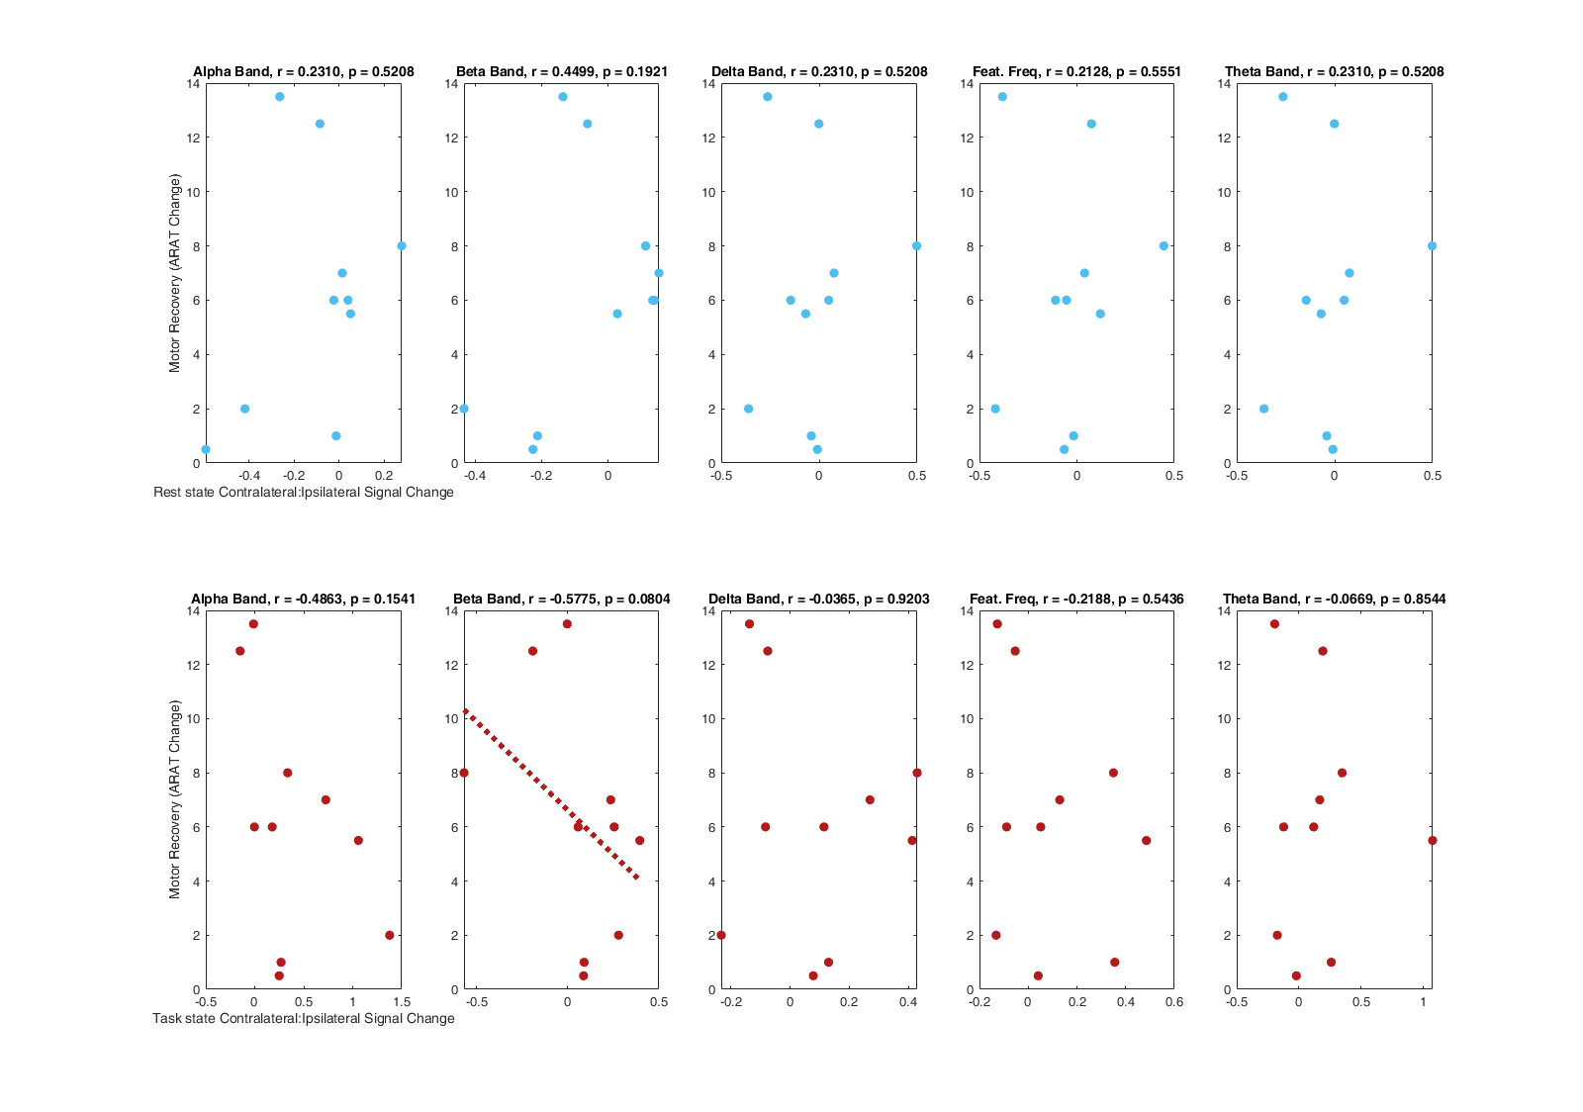
Absolute change in signal lateralites

Slide 3
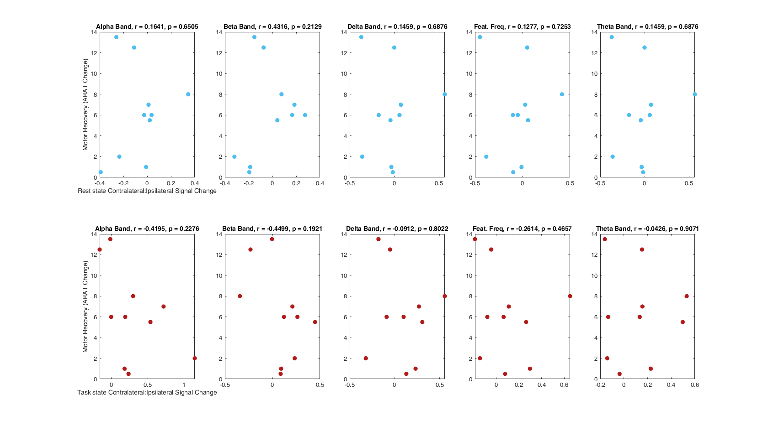
Relative change in signal lateralites

